Slide 1

Bucket List Raleigh
An app to discover Downtown Raleigh

Slide 2
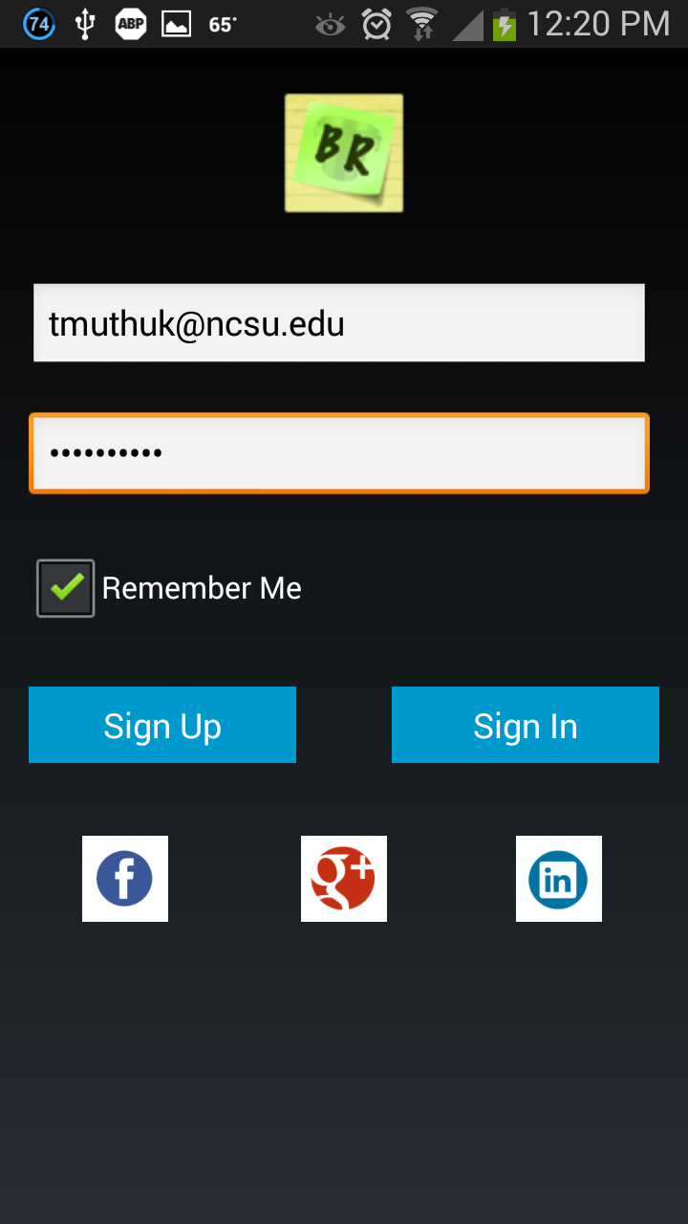
Project Updates – User Login
Sign up
Users can now sign up to use the app
Sign In
User can use their “Bucket List Raleigh” account or social media account to login

Slide 3
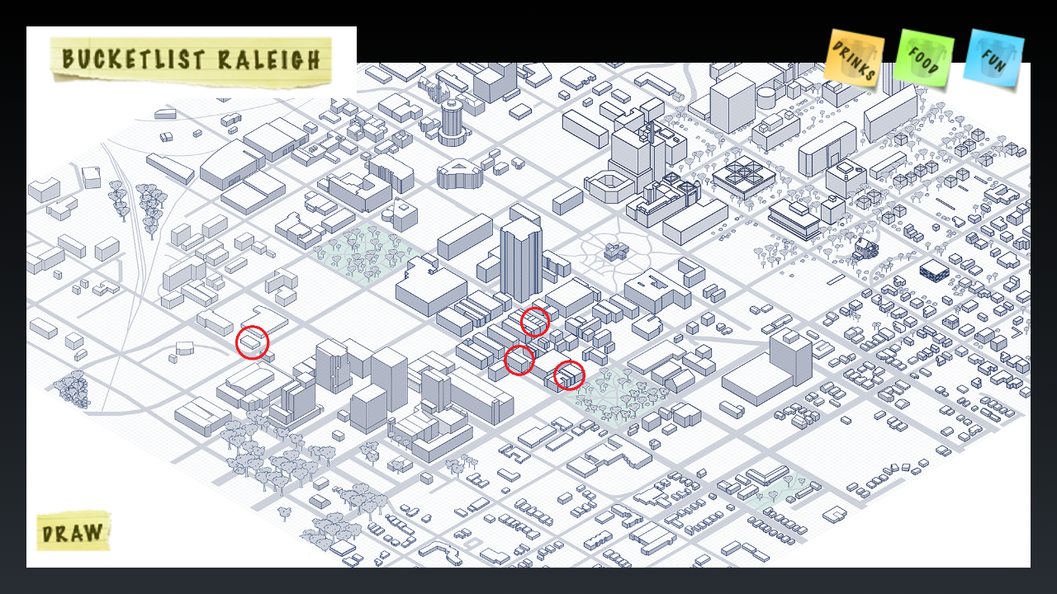
Project Updates – Building Highlights Based on Filter

Slide 4
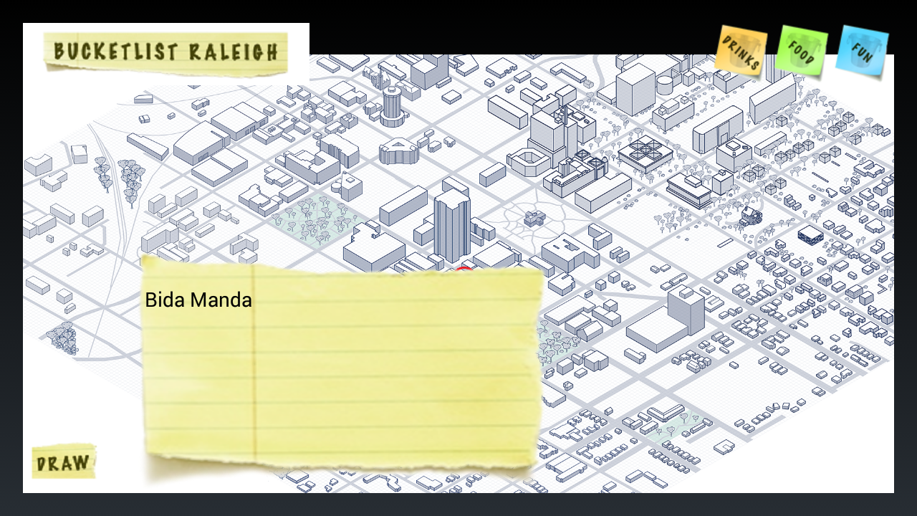
Project Updates – Sticky Note Popup on Clicking Building

Slide 5
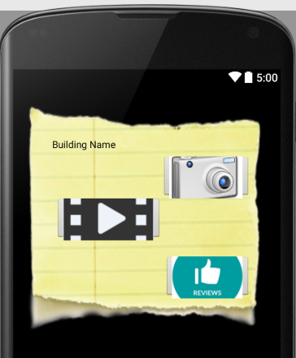
Project Updates – Popup Sticky Note with Buttons
Highlighted Buildings are Clickable
On clicking a highlighted building, the sticky note will pop up now
On clicking outside the sticky note, it will close
The Sticky note now has clickable buttons
Photo Button – takes you to the Photo gallery for the building
Review Button – takes you reviews of the building
Video Button – takes you to videos of the building

Slide 6
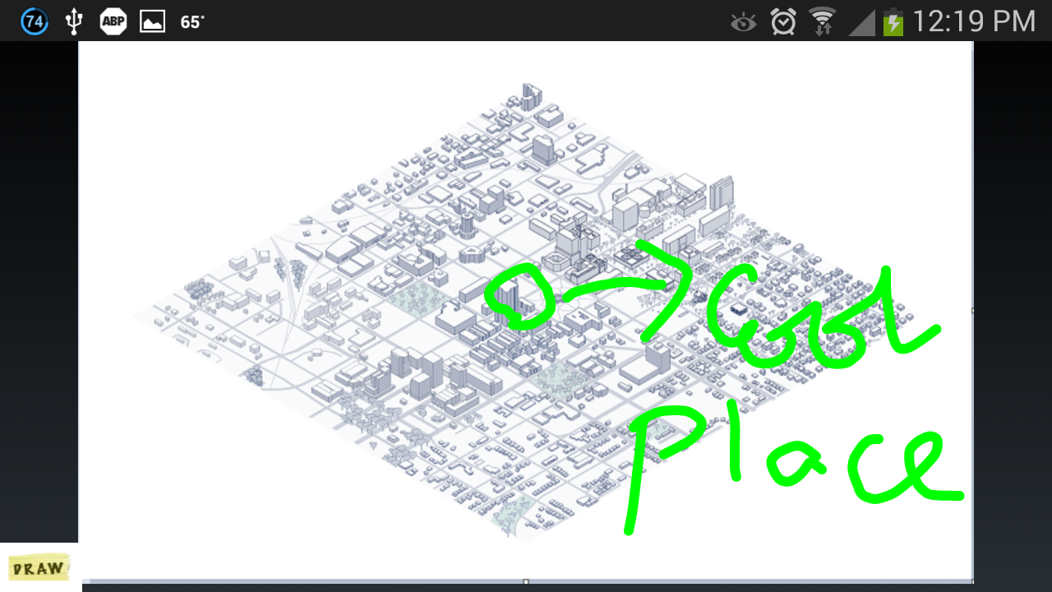
Project Updates – Doodle on Map
Draw button allows users to doodle on the map
Users can select the draw button and draw over the map
We plan to put multiple color palate next

Slide 7
Project Issues – Loading SVG image
There is lack of native support for SVG image in Android
We are unable to load the SVG format image provided for us
On modifying the image, while we were able to load, the other modules such as zoom seems disabled.
No support our current zoom function

Slide 8
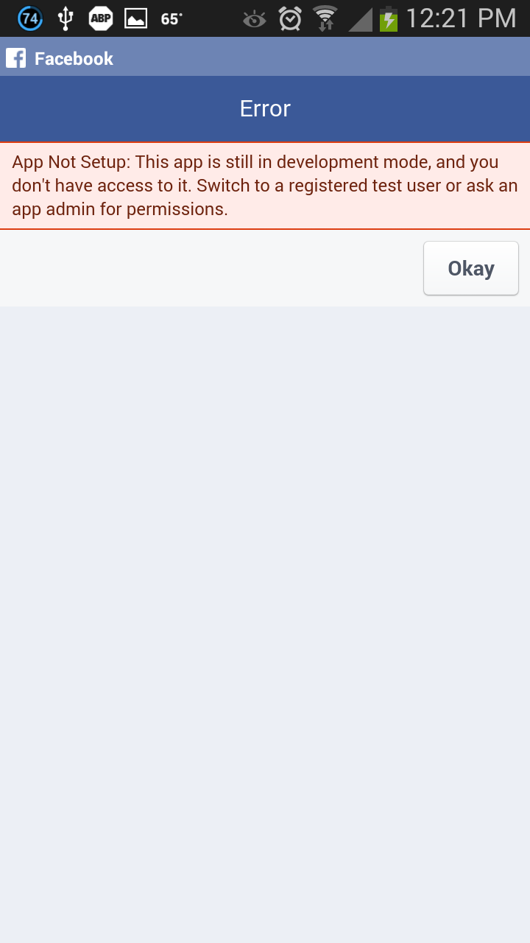
Project Issues – Facebook Login Integration

Slide 9
Road Map
Allowing users to add contents (Reviews) to the building data.
Solving Facebook Integration Key issue
Increasing color options for Doodle (Extra Credit)
Saving Doodle image and sharing it with friends
Bucket Map Raleigh Team
Haizhou Wu
Tamilthaaragai Muthukumar
Nupur Mallik
Nithya Pari
Viral Sanghvi

